Slide 1

KERAS
CSCI 4360/6360: Data Science II
Presented by:
Zirak Khan
Aditya Patel
Department of Computer Science
University of Georgia

Slide 2
Introduction
Developed by Francois Chollet in March 2015
Keras is a high-level neural networks API
Capable of running on top of TensorFlow, CNTK, or Theano
It was developed with a focus on enabling fast experimentation. Being able to go from idea to result with the least possible delay is key to doing good research
Installation: conda install keras

Slide 3
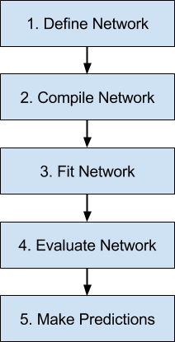
Life Cycle for Neural Network model

Slide 4
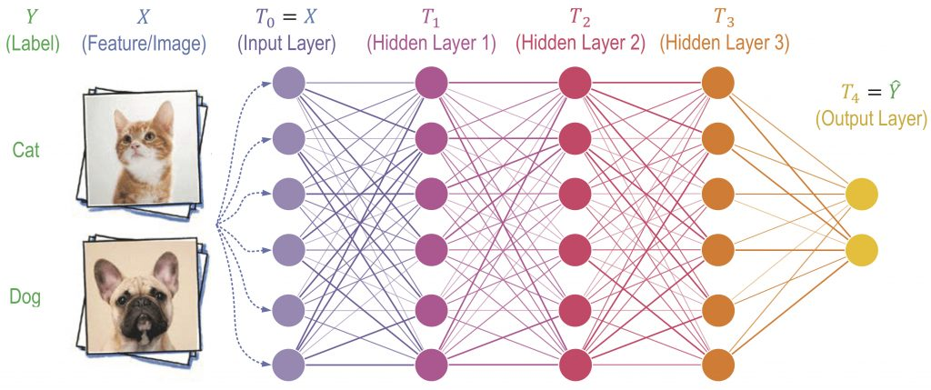
Information flow in Deep Neural Networks

Slide 5
Types of Models in Keras:
Sequential Model:
The sequential model is the linear stack of layers.
It is limited in that it does not allow you to create models that share layers or have multiple inputs or outputs.
Functional Model
The Keras functional API is the way to go for defining complex models, such as multi-output models, directed acyclic graphs, or models with shared layers.

Slide 6


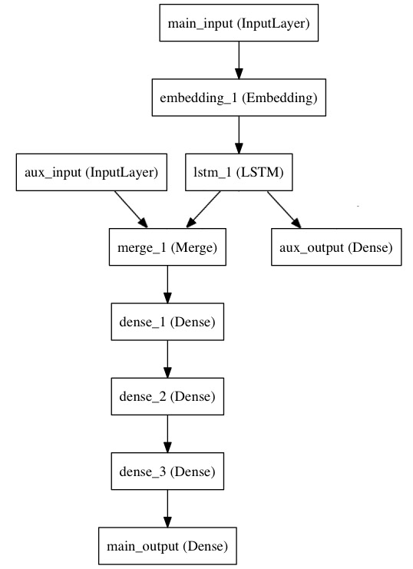
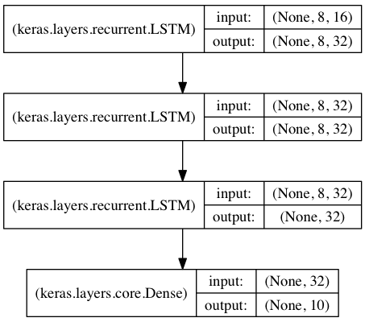




Slide 7
Defining and adding layers to Sequential Model
Specifying input size with in a layer:
Passing batch size(optional)
Giving input_shape (size tuple)
If both batch size (a) and input_shape(x,y) are passed, it will expect every batch input of batch shape (a,x,y)
Needs to be specified only for the first layer, as other layers can inference the shape automatically.

Slide 8
layer.get_weights(): returns the weights of the layer as a list of Numpy arrays.
layer.set_weights(weights): sets the weights of the layer from a list of Numpy arrays (with the same shapes as the output of get_weights)
sets the weights of the layer from a list of Numpy arrays (with the same shapes as the output of get_weights)
Selecting activation function:
Understanding : https://medium.com/the-theory-of-everything/understanding-activation-functions-in-neural-networks-9491262884e0
Layer.get_weights() : returns the weights of the layer as a list of Numpy arrays.
Layer.set_weights(weights) : sets the weights of the layer to weights array, with the same shape as output of Layer.get_weights().

Slide 9
Compiling the model
Before training the model, we need to configure the learning process.
It requires three arguments:
An optimizer: Specifies how do we want to reduce the loss function https://keras.io/optimizers/
Loss function: Measures difference between predicted value (Y) and actual value (Y’)
https://keras.io/losses/
A list of metric: A metric is a function that is used to judge the performance of your model.
https://keras.io/metrics/

Slide 10
Fitting the model
Trains the model for a fixed number of epochs (iterations on a dataset).
Arguments:
X: input
Y: output
Epochs: Number of iterations on each dataset

Slide 11
Evaluating the model
Returns the loss value & metrics values for the model in test mode.
evaluate(x, y, batch_size=None)
x : input array
y : output array
Batch size (optional): number of samples per gradient update, default is 32.

Slide 12
Prediction
It takes input and returns the predicted values in an array
predict(x, batch_size=None, verbose=0)
x : input array
Batch size (optional): number of samples per gradient update, default is 32.
verbose(optional) : 0, 1(default) or 2. Displays additional information like loss function values and accuracy on each epoch iteration.

Slide 13
Thank you!

